Slide 1
Mastermind: Guessing the Code using Donald Knuth’s Algorithm
https://github.com/CloudMojos/CSE2-Project

Slide 2
Introduction and Hypothesis
This research paper presents a website program using Donald Knuth's algorithm to solve the Mastermind game in 5 moves or less.
The program is written in HTML, CSS, and JavaScript and allows users to play the game and observe the efficiency of Knuth's algorithm.
The implementation and testing of the program show that the use of Knuth's algorithm significantly improves the performance of solving the Mastermind game, providing a user-friendly and interactive way to learn about the algorithm and its applications.

Slide 3
Introduction and Hypothesis
Null Hypothesis (H0): The use of Donald Knuth's algorithm with the minimax approach does not significantly improve the performance of solving the Mastermind game compared to other traditional methods.
Alternative Hypothesis (H1): The use of Donald Knuth's algorithm with the minimax approach significantly improves the performance of solving the Mastermind game compared to other traditional methods.

Slide 4
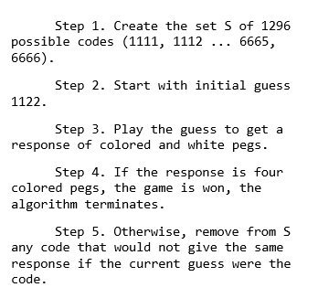
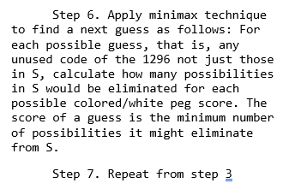
Methods and Experimental Logic
The researchers used the summarized content of the paper The Computer as Master Mind by Donald Knuth.

Slide 5
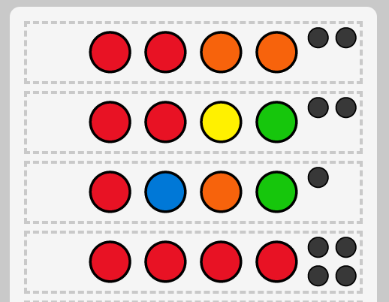
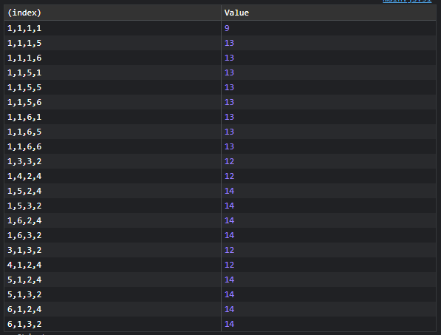


Procedures
The researchers used the tools available to test the algorithm in action.

Slide 6










Procedures

Slide 7














Procedures

Slide 8














Procedures

Slide 9








Procedures

Slide 10
Results
🧠 Mastermind (cloudmojos.github.io)

Slide 11
Results
Null Hypothesis (H0): The use of Donald Knuth's algorithm with the minimax approach does not significantly improve the performance of solving the Mastermind game compared to other traditional methods.
Alternative Hypothesis (H1): The use of Donald Knuth's algorithm with the minimax approach significantly improves the performance of solving the Mastermind game compared to other traditional methods.

Slide 12
Discussion and Conclusion
In conclusion, this research supports the alternative hypothesis (H1) that the use of Donald Knuth's algorithm with the minimax approach significantly improves the performance of solving the Mastermind game compared to other traditional methods.

Slide 13
Discussion and Conclusion
The results of the implementation and testing of the website program showed that the algorithm was highly effective and accurate in providing a solution to the game. The results of this research make a significant contribution to the field of computer science and demonstrate the potential of using algorithms and the minimax approach in solving classic code-breaking games. The website program developed in this research provides a valuable solution to the problem, combining the benefits of an interactive and user-friendly experience with the accuracy and reliability of the algorithm.

Slide 14
Thank You! 🎉🎊

